Slide 1
Introduction to Operating Systems
Notes:
Video Module 1-01

Slide 2

Overview
Objectives
Review/tour the key components of a Computer System
Learn about and understand an operating system
Learn and understand the role/duties of an operating system:
Processes Management
Memory management
(External) Storage Management
I/O System
Protection and Security
Requirements
Passing grade in COMP 2710 and (COMP 3350 or ELEC 2220)
Complete assigned readings

Slide 3
Computer System Review
What is an Operating System?
What is a Computer System?
Why would a Comp. System need an Operating System?
Key mechanisms that help an OS fulfill its mission
Interrupts
Direct Memory Access (DMA)

Slide 4
What is an Operating System (OS)?
An OS is a PROGRAM (piece of software) that makes the use of a computer system convenient, secure, and efficient.
This definition raises some questions:
What is a computer system?
Why would we need an OS?
(Can’t a computer system and its user(s) take care of themselves?)
What does “efficient” mean?

Slide 5
What is a Computer System?
Computer system is made of four major components:
Hardware (Computer) – provides basic computing resources
CPU, memory, I/O devices
Operating system
Controls, coordinates, and optimizes use of hardware among various applications and users
Application programs – define the ways in which the system resources are used to solve the computing problems of the users
Word processors, compilers, web browsers, database systems, video games
Users
People, machines, other computers

Slide 6
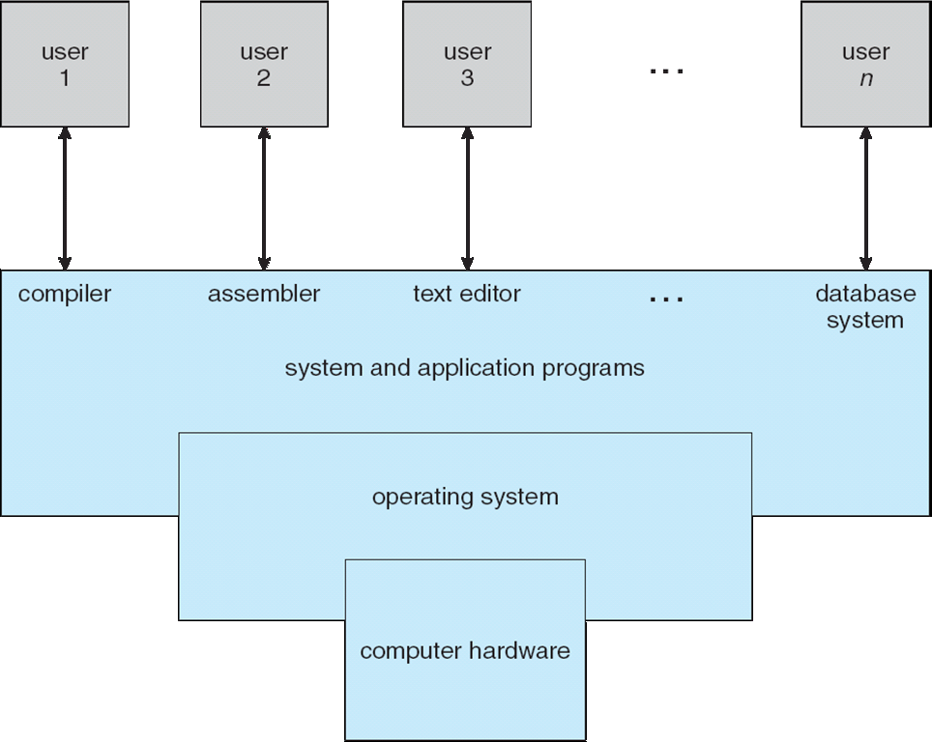
Four Components of a Computer System
Software

Slide 7
A Computer Is a Von Neumann Machine
A Von Neumann Machine (Architecture) consists of a machine with:
A processing unit containing a logic and arithmetic unit (ALU) and registers (storage): particularly an instruction register and a program counter register
A memory system that stores instructions (program) and data
An external mass storage
An input/output system
All computer-based devices (desktop, laptops, cellphones, cameras, washing machines….) have the Von Neuman Architecture (known also as the Princeton Architecture)
A CPU spends all its time:
Reading instructions or data (operands)
OR
Writing back results/data
Notes:
Video Module 1-02

Slide 8
Where does hardware meet the Operating System?
bootstrap program is loaded at power-up or reboot
Typically stored in ROM or EPROM, generally known as firmware
Initializes all aspects of system
Loads operating system kernel and starts execution

Slide 9
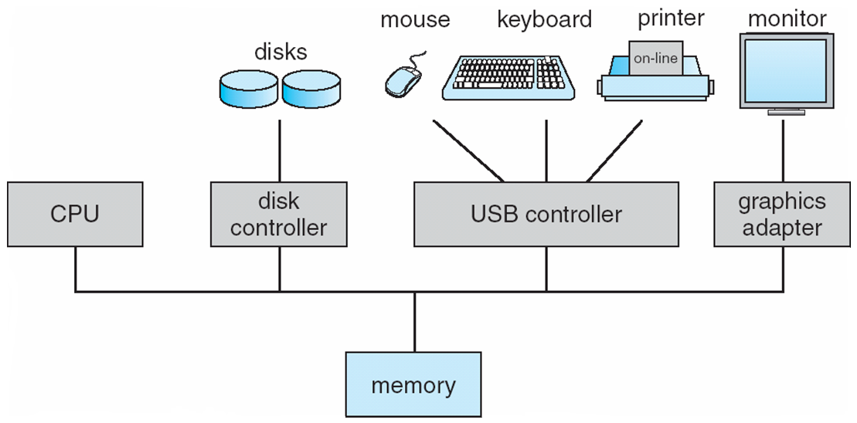
Computer System Organization
Computer-system operation
One or more CPUs, device controllers connect through common bus providing access to shared memory
Concurrent execution of CPUs and devices competing for memory cycles
DMA

Slide 10
Computer-System Operation
I/O devices and the CPU can execute concurrently
Each device controller is in charge of a particular device type
Each device controller has a local buffer
CPU directs data from/to main memory to/from local buffers
Device controller informs CPU that it has finished its operation by causing an interrupt

Slide 11
Why would a Comp. System need an Operating System?
Answer: Input/Outputs are very slow in comparison the CPU speed
CPU is not well suited from transferring data from the main memory to the I/O system (display, mass storage, network…..)
I/O system is in general slow compared to the CPU.
I/O operations are NECESSARY and occur often (get new data to process (Input) and deliver new results).
Questions:
Should the CPU be used to transfer data between memory and I/O system?
If not,
who should perform the transfers?
Since the CPU is not used during the data transfers, what to do with the CPU during these data transfers?

Slide 12
A key (Important) Mechanism : Interrupts
What is an interrupt?
In short, a mechanism to call a routine (method) using an external hardware event (key stroke, network packet arrival, mouse click, inserting a USB device, …)
What for?
Response time: address immediately users/devices requests/events
How does it work?
During the initialization, an interrupt routine handler (IRH) is associated/mapped with an event.
When the event occurs,
the CPU saves the current program counter (to return later) as well as other registers
the CPU uses that mapping to determine which IRH to call.
The IRH is executed
Registersare restored
The program counter is restored (the CPU returns to the interrupted thread… ).
An operating system is essentially interrupt-driven.
A trap is a software interrupt triggered by user’s request, faults, or exceptions.

Slide 13
Another key (Important Mechanism): Direct Memory Access
DMA: A critical/important hardware component
DMA is a hardware device that transfer blocks of data between the I/O buffers and the main memory.
How does DMA work?
The OS will provide as inputs the source address SA, the destination address DA, and the length L of the block to transfer. DMA will copy L bytes from source address S to destination address DA.
When the DMA completes the transfer, it interrupts the OS.
Benefits:
DMA transfers can be completed concurrently with CPU operations
Device controller transfers blocks of data from buffer storage directly to main memory without CPU intervention
Only one interrupt is generated per block, rather than one interrupt per byte

Slide 14
Operating System Overview
Questions:
Should the CPU be used to transfer data between memory and I/O system?
If not,
who should perform the transfers?
Since the CPU is not used during the data transfers, what to do with the CPU during these data transfers?
What is an Operating System?
Role/functions/Services of an OS
Process Management
Memory Management
Storage Management
I/O System
Protection and Security
Notes:
Video Module 1-03

Slide 15
Why is an OS needed?
Questions:
Should the CPU be used to transfer data between memory and I/O system?
No
It would be time inefficient (each transfer involves reading multiple instructions, reading the source, writing the destination, updating pointers to source and destination)
Transfer is a very simple operation that can be handled by hardware using the DMA device.
If not,
who should perform the transfers?
DMA
Since the CPU is not used during the data transfers, what to do with the CPU during these data transfers?
We could have many other users or other applications “in the system” with the hope that AT LEAST one of them is ready to use the CPU (i.e., it is not performing I/O operations)
If we have many users or applications “in the system” then we must share the computer system resources among them efficiently and fairly.

Slide 16
So, What IS an Operating System?
OS is a program: a piece of software.
OS is a resource allocator
Manages all resources (CPU, memory system, I/O)
Decides between conflicting requests for efficient and fair resource use
OS is a control program
Controls execution of programs to prevent errors and improper use of the computer
Remarks:
No universally accepted definition
“Everything a vendor ships when you order an operating system” is good approximation, but varies wildly
“The one program running at all times on the computer” is the kernel. Everything else is either a system program (ships with the operating system) or an application program.

Slide 17
Resources To Manage
CPU to be shared among
users?
“applications”?
processes ?
or threads?
Memory System to be shared
within a process
I/O System

Slide 18
“Keeping Many …. In the System”
Multiprogramming needed for efficiency
Single user cannot keep CPU and I/O devices busy at all times
Multiprogramming organizes jobs (code and data) so CPU always has one to execute
A subset of total jobs in system is kept in memory
One job selected and run via job scheduling
When it has to wait (for I/O for example), OS switches to another job
Timesharing (multitasking) is logical extension in which CPU switches jobs so frequently that users can interact with each job while it is running, creating interactive computing
Response time should be < 1 second
Each user has at least one program executing in memory process
If several jobs ready to run at the same time  CPU scheduling
If processes don’t fit in memory, swapping moves them in and out to run
Virtual memory allows execution of processes not completely in memory
18

Slide 19
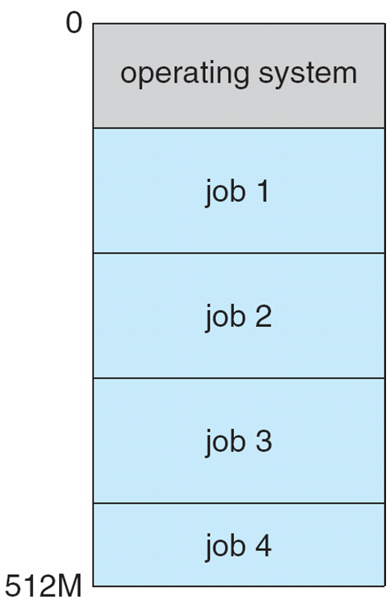
Memory Layout for Multiprogrammed System
19

Slide 20
Memory System
Memory System: an Hierarchy.
Why is the memory system hierarchical?
Role of the OS to manage/move data in the memory system
Notes:
Video Module 1-04

Slide 21
Memory System
Registers
Cache
Main memory – only large storage media that the CPU can access directly
Random access
Typically volatile
Secondary storage – extension of main memory that provides larger nonvolatile storage capacity
Magnetic disks – rigid metal or glass platters covered with magnetic recording material
Disk surface is logically divided into tracks, which are subdivided into sectors
The disk controller determines the logical interaction between the device and the computer
Network (clouds)

Slide 22
Memory System Hierarchy
Storage systems organized in an hierarchy because of
Speed
Cost
Volatility
Faster costs more.
Caching – copying information into faster storage system; main memory can be viewed as a cache for secondary storage

Slide 23
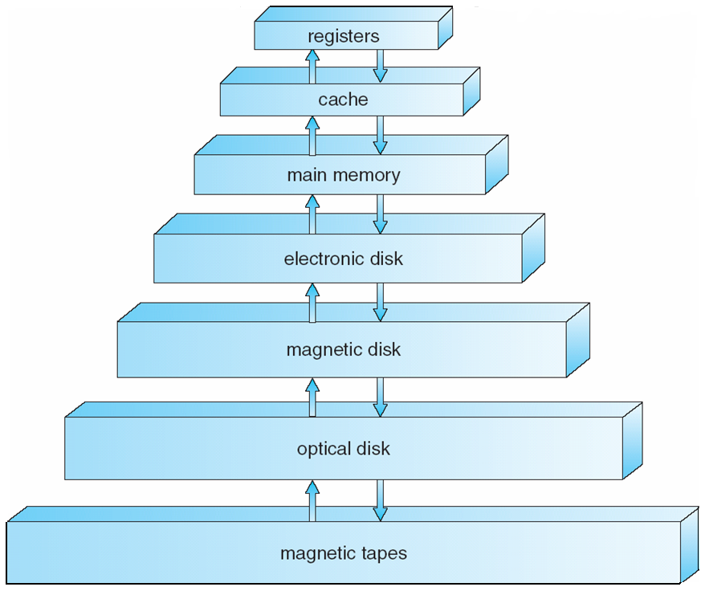
Memory System Hierarchy
Transfers governed by programmer/compiler
Transfers governed by hardware
Transfers governed by OS/User
Access Time
Cost per byte
Size
Disk

Slide 24
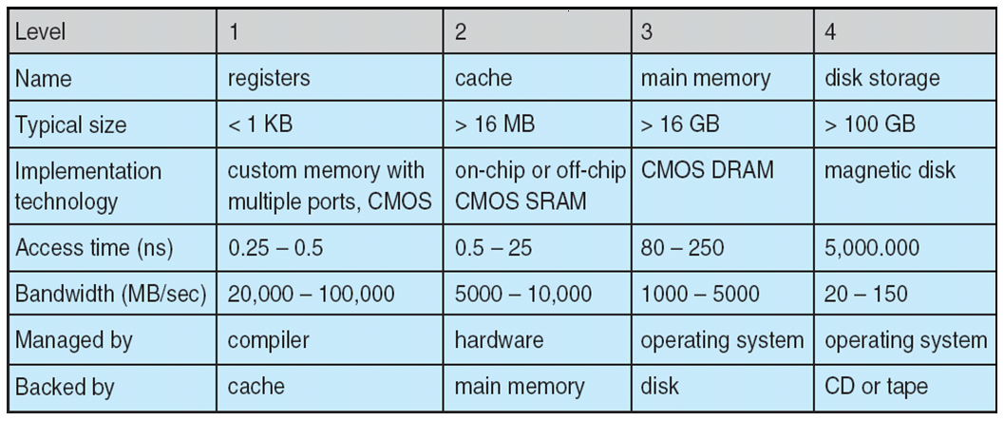
Performance of Various Levels of Storage
Movement between levels of storage hierarchy can be explicit or implicit
Price
?
?
?
?

Slide 25
Caching
The hierarchical memory makes sense ONLY because:
1) Faster costs more
Important principle, performed at many levels in a computer (in hardware, operating system, software)
Information in use copied from slower to faster storage temporarily
Faster storage (cache) checked first to determine if information is there
If it is, information used directly from the cache (fast)
If not, data copied to cache and used there
Cache smaller than storage being cached
Cache management important design problem
Cache size and replacement policy

Slide 26
Why Does Caching Work?
Caching and the hierarchical memory makes sense ONLY because:
Faster memory costs more
Most programs exhibit
Temporal locality: recently used items will be used again
Spatial locality: neighbors of a recently used item will be used soon

Slide 27
Brief OS Duties Overview
Role/functions/Services of an OS
Process Management
Memory Management
Storage Management
I/O System
Protection and Security
Notes:
Video Module 1-05

Slide 28
OS Management Duties
Process Management
Memory Management
Storage Management
I/O subsystem
Protection and Security
These duties differ depending on the kind of computers
General purpose desktops
Servers
Mobile systems
Embedded systems

Slide 29
First, How to Insure that the OS is the BOSS?
Dual mode of CPUs
Kernel (privileged) mode
User mode
Notion of “System Call”

Slide 30
Process Management
A process is a program in execution. It is a unit of work within the system. Program is a passive entity, process is an active entity.
Process needs resources to accomplish its task
CPU, memory, I/O, files
Initialization data
Process termination requires reclaim of any reusable resources
Typically system has many processes, some user, some operating system running concurrently on one or more CPUs
Concurrency by multiplexing the CPUs among the processes / threads
30

Slide 31
Process Management Activities
The operating system is responsible for the following activities in connection with process management:
Creating and deleting both user and system processes
Suspending and resuming processes
Providing mechanisms for process synchronization
Providing mechanisms for process communication
Providing mechanisms for deadlock handling
31

Slide 32
Memory Management
Memory management determines what is in memory when and where
Optimizing CPU utilization and computer response to users
Memory management activities
Keeping track of which parts of memory are currently being used and by whom
Deciding which processes (or parts thereof) and data to move into and out of memory
Allocating and deallocating memory space as needed
32

Slide 33
Storage Management
OS provides uniform, logical view of information storage
Abstracts physical properties to logical storage unit - file
Each medium is controlled by device (i.e., disk drive, tape drive)
Varying properties include access speed, capacity, data-transfer rate, access method (sequential or random)
File-System management
Files usually organized into directories
Access control on most systems to determine who can access what
OS activities include
Creating and deleting files and directories
Primitives to manipulate files and dirs
Mapping files onto secondary storage
Backup files onto stable (non-volatile) storage media
33

Slide 34
Mass-Storage Management
Usually disks used to store data that does not fit in main memory or data that must be kept for a “long” period of time
Proper management is of central importance
Entire speed of computer operation hinges on disk subsystem and its algorithms
OS activities
Free-space management
Storage allocation
Disk scheduling
Some storage need not be fast
Tertiary storage includes optical storage, magnetic tape
Still must be managed – by OS or applications
Varies between WORM (write-once, read-many-times) and RW (read-write)
34

Slide 35
I/O Subsystem
One purpose of OS is to hide peculiarities of hardware devices from the user
I/O subsystem responsible for
Memory management of I/O including buffering (storing data temporarily while it is being transferred), caching (storing parts of data in faster storage for performance), spooling (the overlapping of output of one job with input of other jobs)
General device-driver interface
Drivers for specific hardware devices
35

Slide 36
Protection and Security
Protection – any mechanism for controlling access of processes or users to resources defined by the OS
Security – defense of the system against internal and external attacks
Huge range, including denial-of-service, worms, viruses, identity theft, theft of service
Systems generally first distinguish among users, to determine who can do what
User identities (user IDs, security IDs) include name and associated number, one per user
User ID then associated with all files, processes of that user to determine access control
Group identifier (group ID) allows set of users to be defined and controls managed, then also associated with each process, file
36

Slide 37
Special-Purpose Systems
Real-time embedded systems most prevalent form of computers
Vary considerable, special purpose, limited purpose OS, real-time OS
Multimedia systems
Streams of data must be delivered according to time restrictions
Handheld systems
PDAs, smart phones, limited CPU, memory, power
Reduced feature set OS, limited I/O
37

Slide 38
Wrap Up
Review/tour the key components of a Computer System
Learn about and understand an operating system
Learn and understand the role/duties of an operating system:
Processes Management
Memory management
Storage Management
I/O System
Protection and Security
Notes:
Video Module 1-06

